Slide 1
Derived Data Challenges in Single-cell Profiling
Or, “I have profiles but where did the images go?”

Slide 2
Outline
Definitions
Pipelines and exports
Future
What if …?

Slide 3

Definitions
https://dagster.io/glossary/data-derivation

Slide 4
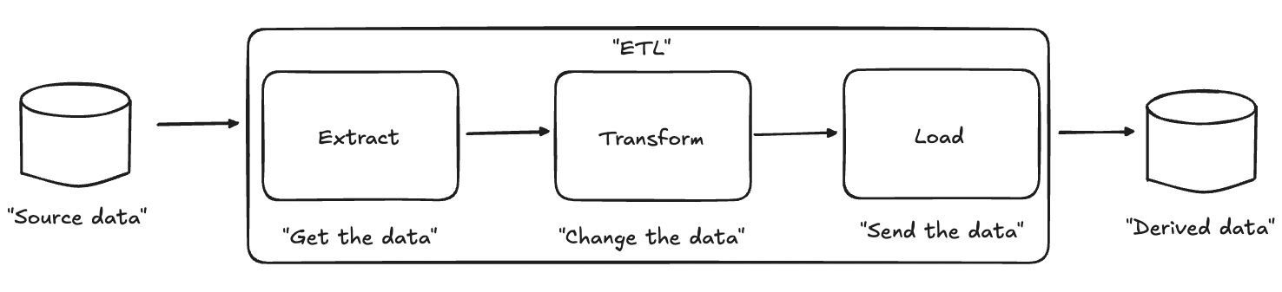
Definitions
https://en.wikipedia.org/wiki/Extract,_transform,_load

Slide 5
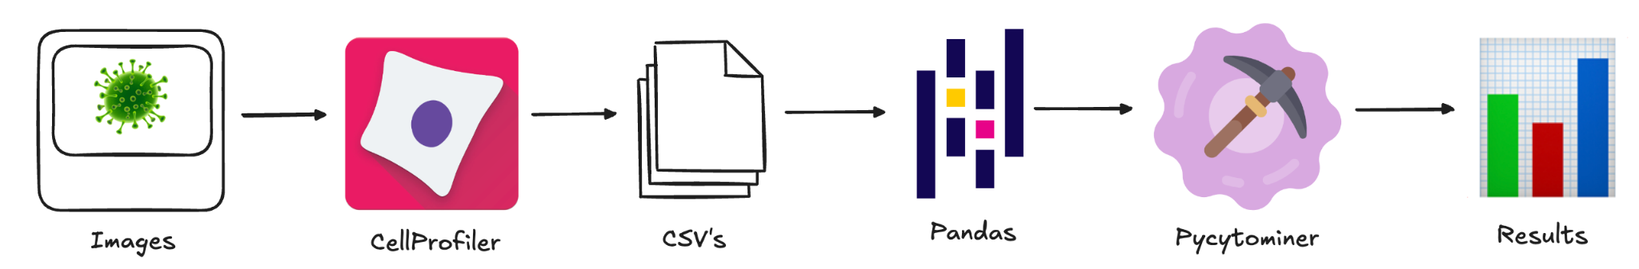
Pipelines and exports
Create single-cell profiles with CellProfiler as CSV’s then read them with Pandas, process with Pcytominer, and create results.

Slide 6
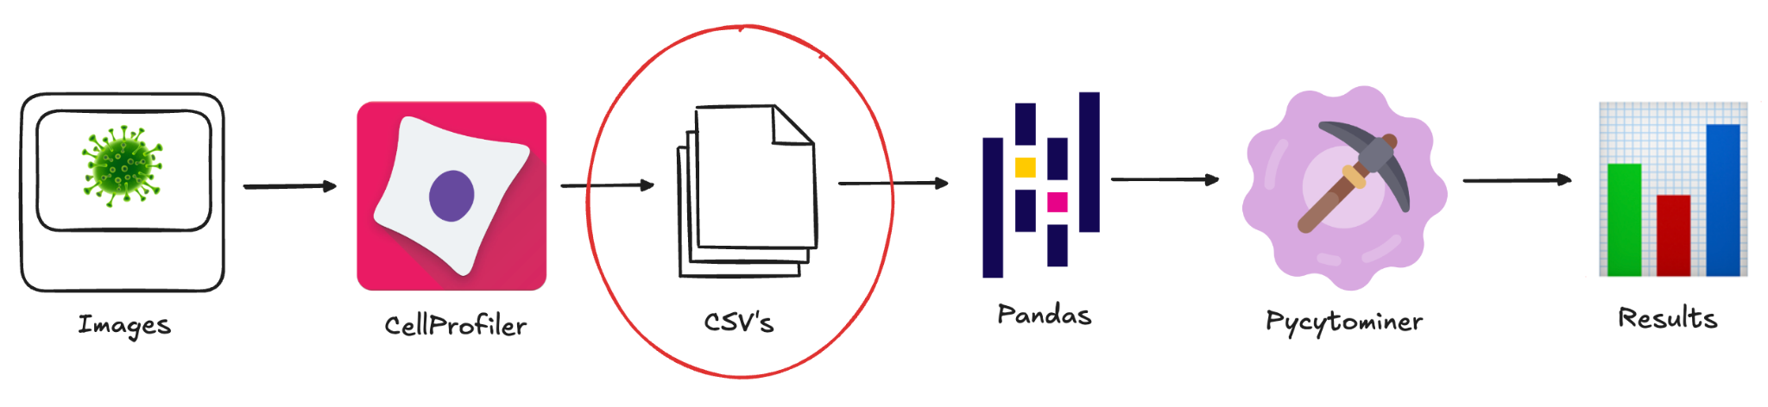
Pipelines and exports
Challenge: CSV’s were not built for large data operations, do not include data types, and are prone to value errors (for example, null types and floating point precision). They also have no relational model.

Slide 7
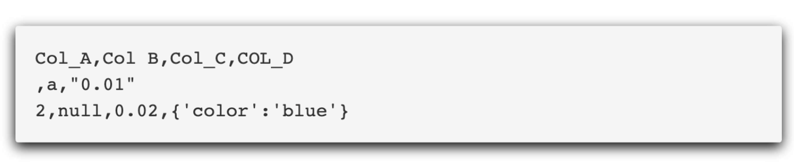
Pipelines and exports
Consider the above example: multiple data types in single columns, multiple null type values, inconsistent naming, and complex data.

Slide 8
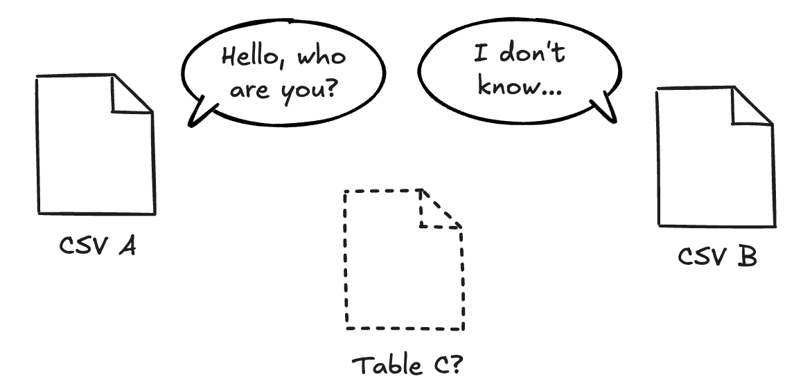
Pipelines and exports
CSV’s have no relational model. They’re all standalone files who don’t know about one another, meaning we have to infer or reinvent for any join.

Slide 9
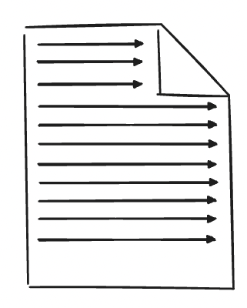
Pipelines and exports
CSV’s must be read sequentially when extracting data (we have to read all columns and each row when gathering things). Data types are implied and converted through the reader. This takes a long time!

Slide 10
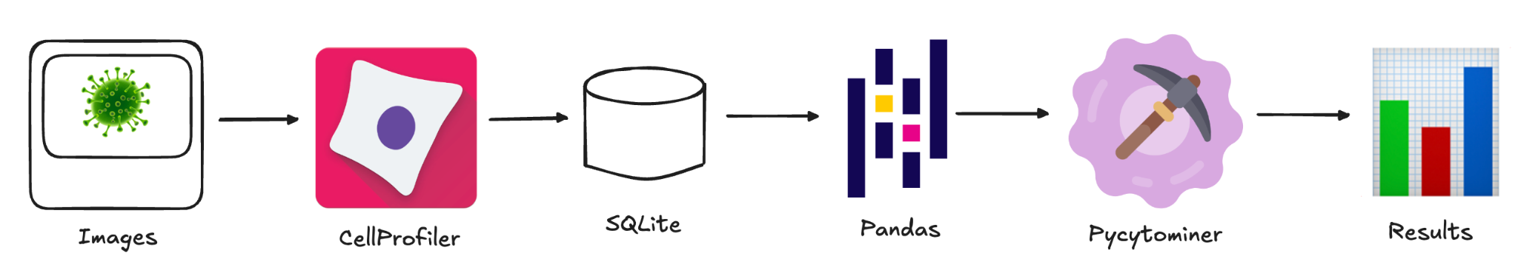
Pipelines and exports
We can solve some of these problems with SQLite, an embeddable database. CSV files become binary tables that include affinity types within a relational model.

Slide 11
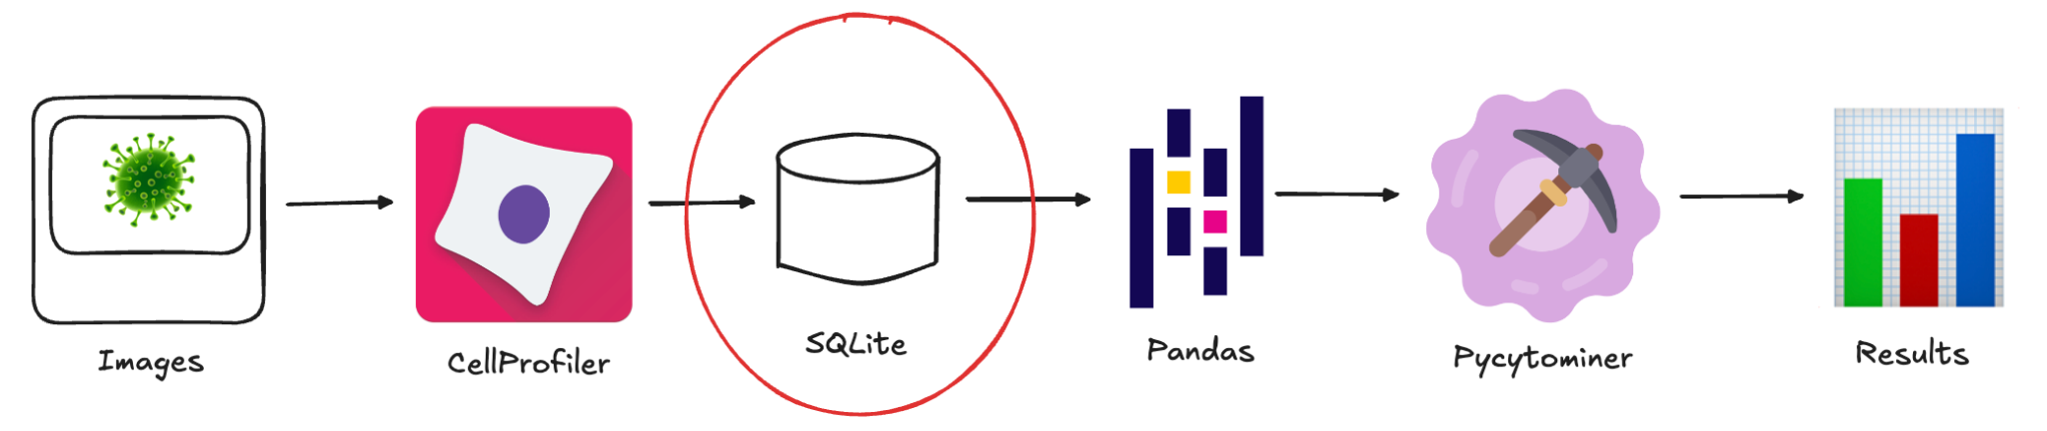
Pipelines and exports
Challenges: affinity types entail implied but not required, the model must also be maintained in order to be useful, and SQLite is not optimized for large data operations.

Slide 12
Pipelines and exports
-- Affinity types example
-- Create the table
CREATE TABLE research_data (
standard_column INTEGER,
made_up_column FLUXCAPACITOR
);
-- Insert mixed values
INSERT INTO research_data (standard_column, made_up_column)
VALUES (1, 'text_value');
INSERT INTO research_data (standard_column, made_up_column)
VALUES (2, 3.14159);
SELECT * FROM research_data;
>
1|text_value
2|3.14159

Slide 13
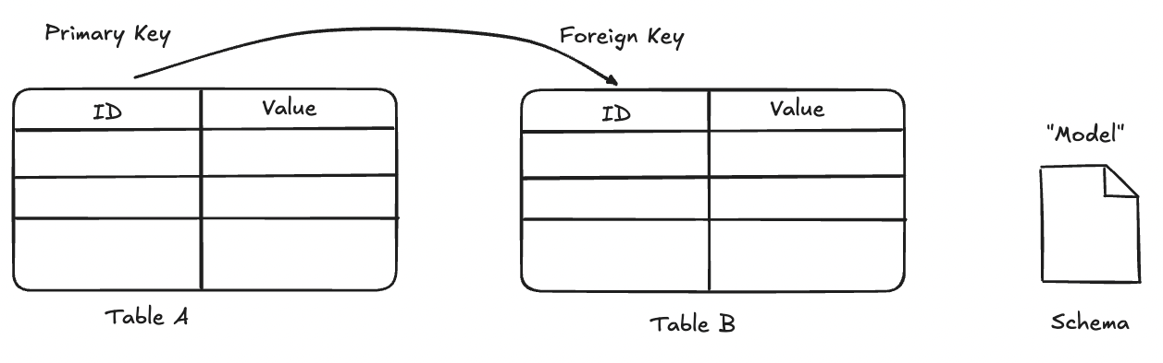
Pipelines and exports
We can store the data relationships as a model within the SQLite schema.

Slide 14
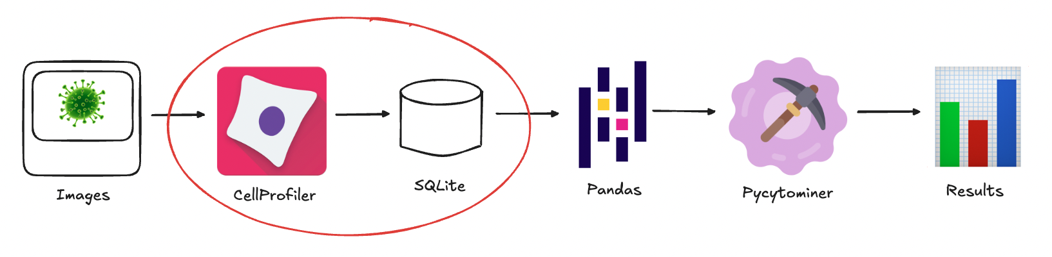
Pipelines and exports
We have to modify the model upstream (it’s defined by CellProfiler exports).

Slide 15

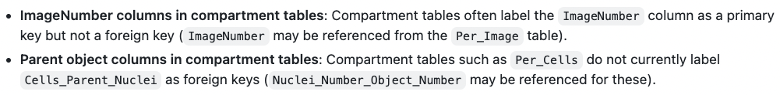
Pipelines and exports
https://github.com/CellProfiler/CellProfiler/issues/4949

Slide 16
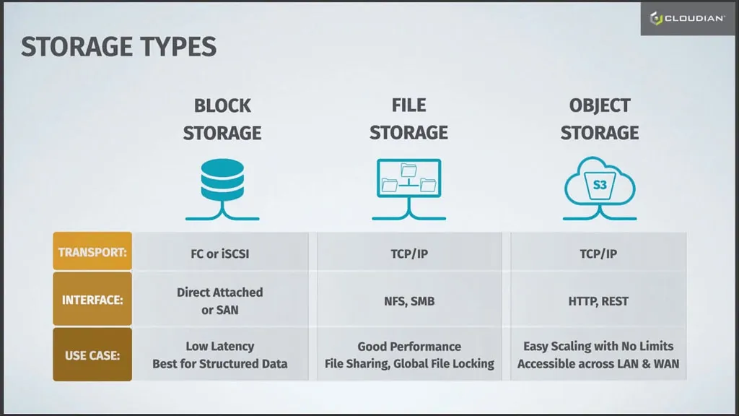
Pipelines and exports
SQLite uses block storage through a filesystem.
https://cloudian.com/blog/object-storage-care/

Slide 17
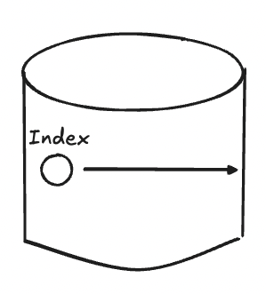
Pipelines and exports
SQLite enables quicker data extraction through indexes, meaning we don’t need to read sequentially for many cases. Much faster than CSV’s.

Slide 18
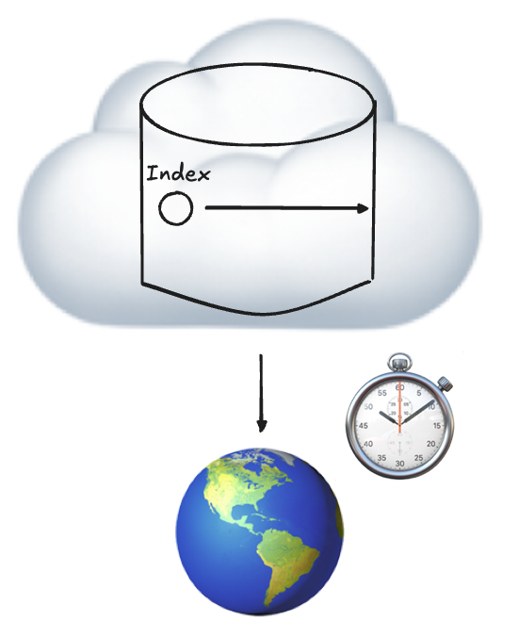
Pipelines and exports
We can only gain that benefit through the local filesystem (we have to download the entire file from cloud storage).

Slide 19
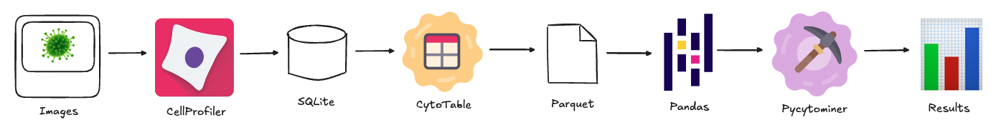
Pipelines and exports
We can use CytoTable to create data which is purpose built for large data operations (incl. cloud), has strict data types, and use single-cell records as a model.

Slide 20
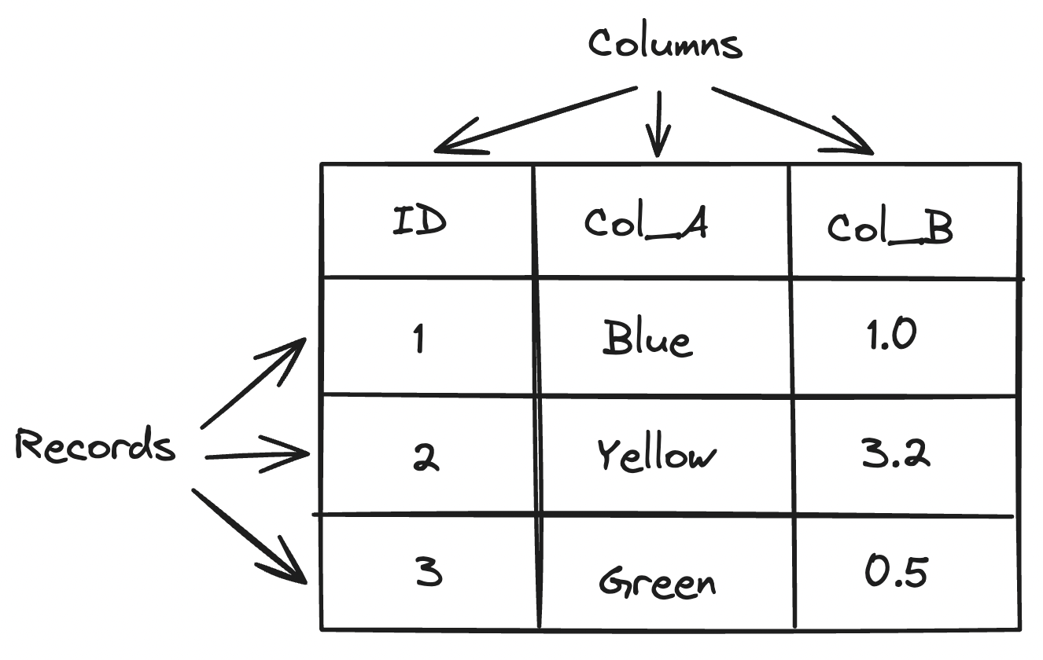
Pipelines and exports
We use one table to imply the relationship among all columns through rows (records) of single-cell objects. This reduces complexity without losing a model.

Slide 21
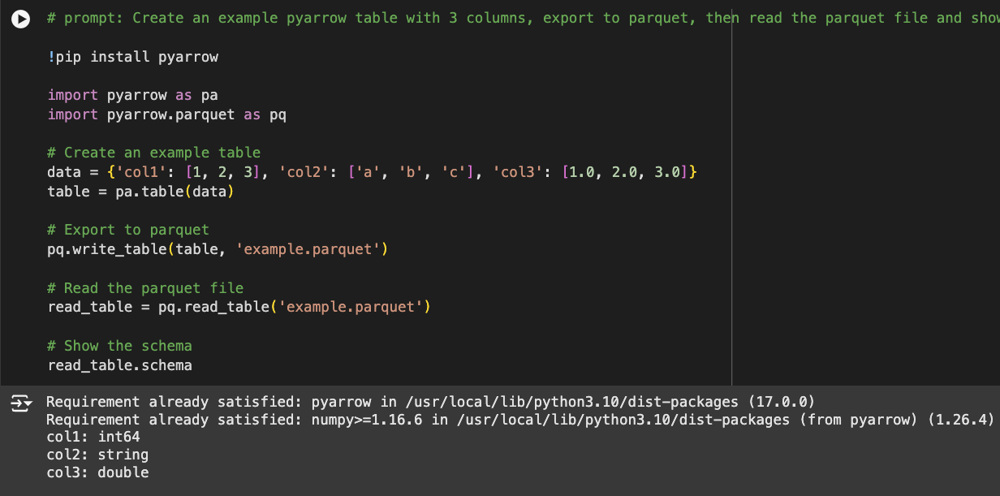
Pipelines and exports
Parquet columns and values are strict: column and value types must exist and must match. https://colab.research.google.com/drive/1pkitiLmbp_JlNSp1UIISafY8NjNvtrkc?authuser=0#scrollTo=vJ1kjYjIcUDR

Slide 22
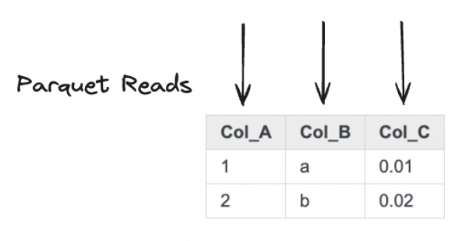
Pipelines and exports
Parquet reads are “columnar” meaning we don’t need to scan each row and we gain efficiencies.

Slide 23
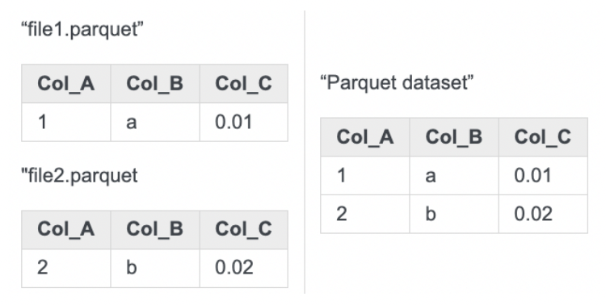
Pipelines and exports
Parquet tables can be composed of one or many individual files (we aren’t constrained to a single file). Multi-file Parquet tables are called “datasets”.

Slide 24
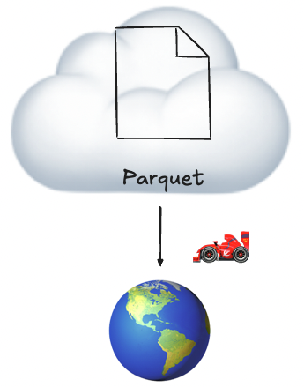
Pipelines and exports
Parquet is optimized for cloud storage, meaning we have greater flexibility when it comes to storage and distribution.

Slide 25
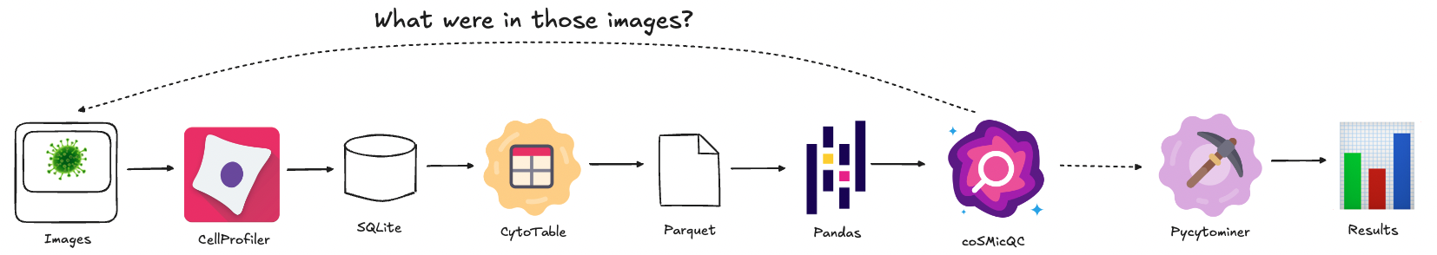
Pipelines and exports
What if we need to go back to where the data was derived from (the images)?
https://github.com/WayScience/coSMicQC

Slide 26
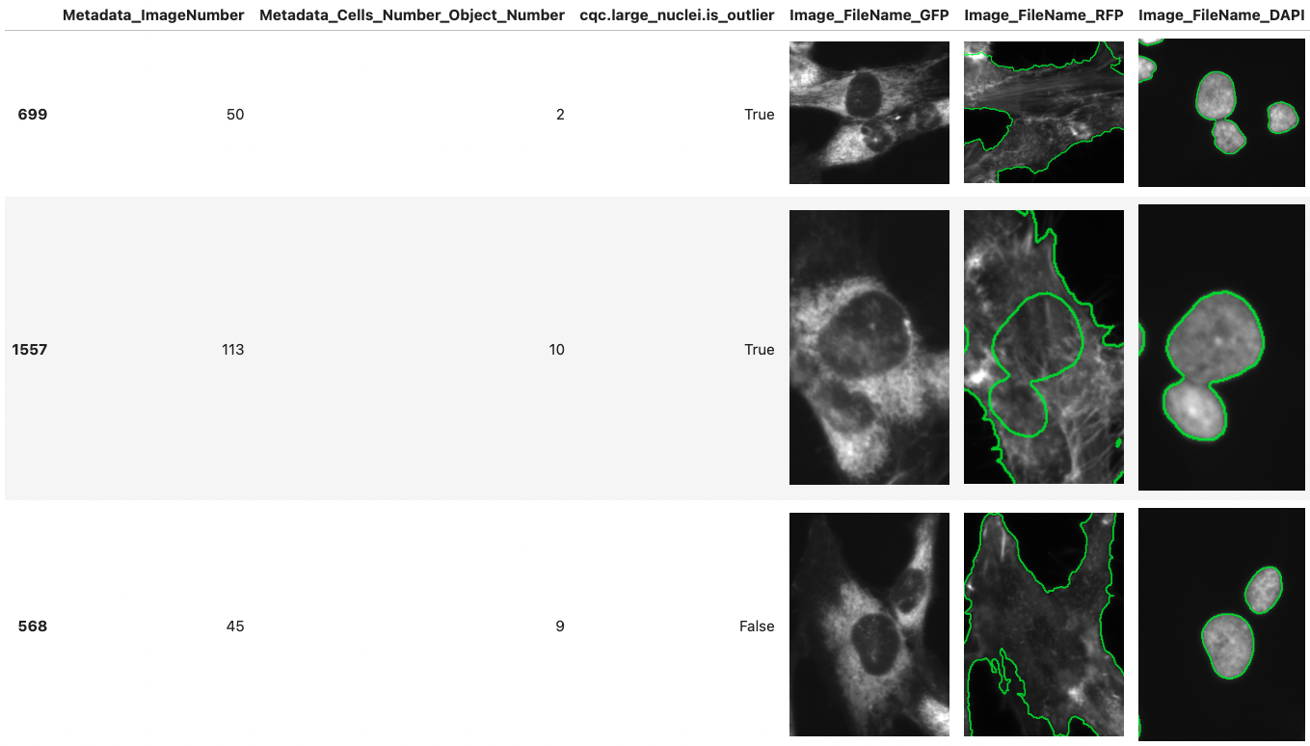
Pipelines and exports
We can view image data alongside the profiles if the image data are available.
https://github.com/WayScience/CytoDataFrame

Slide 27
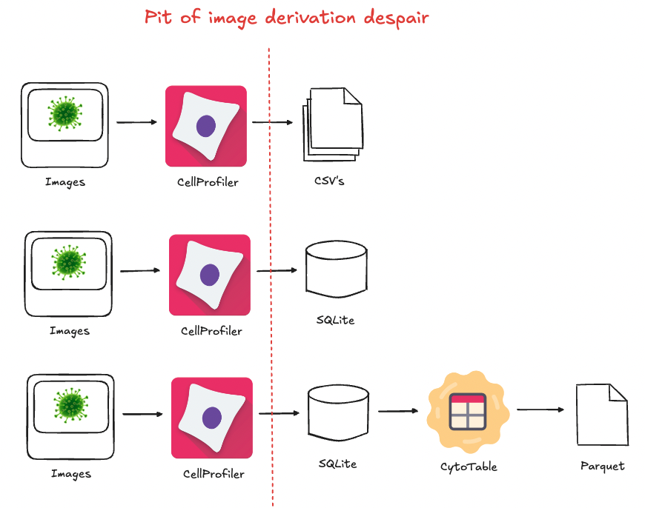
Pipelines and exports
Pit of image derivation despair: we’re leaving behind the images with potentially no provenance back.

Slide 28
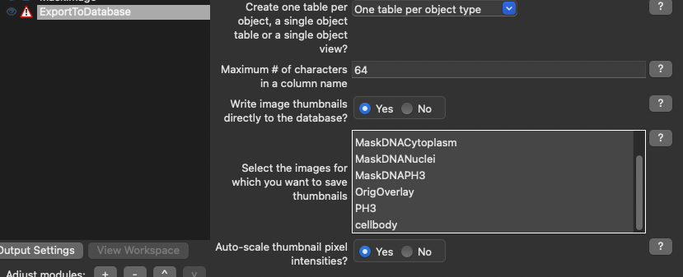
Pipelines and exports
Can we export images through CellProfiler module settings?

Slide 29
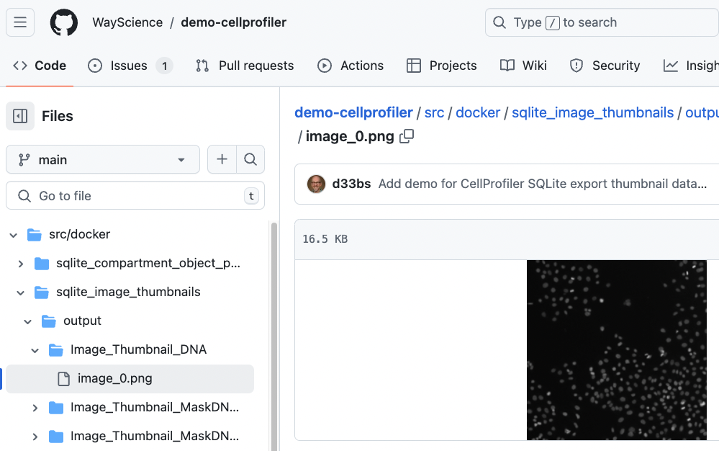
Pipelines and exports
No. ☹

Slide 30
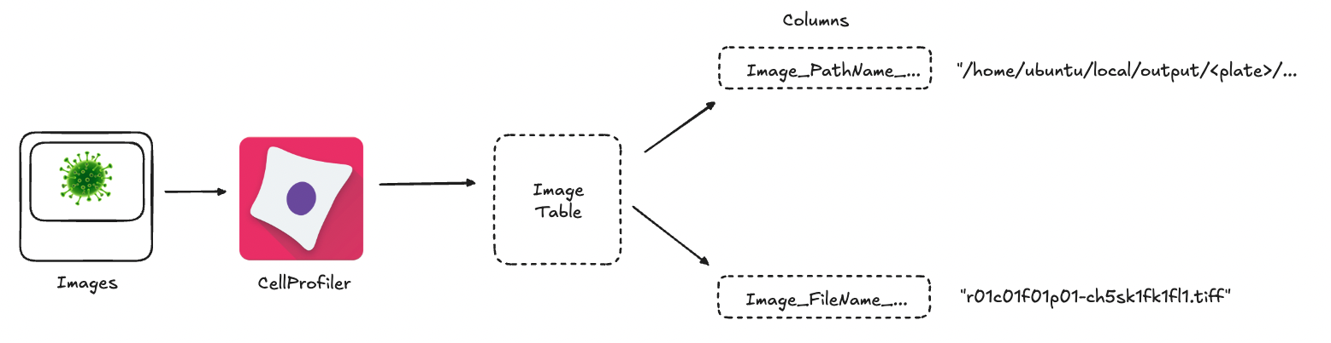
Pipelines and exports
CellProfiler Image table output includes some clues.
Derivational data stored through “Image_FileName_…” column values.

Slide 31
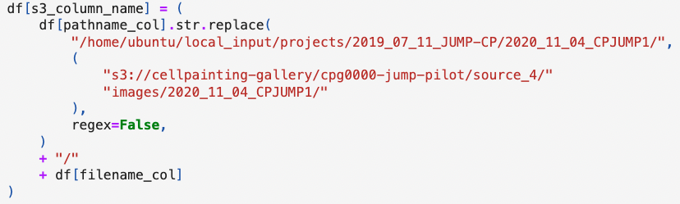
Pipelines and exports
We can fix this, but it’s ugly and will result in bespoke solutions every time.

Slide 32
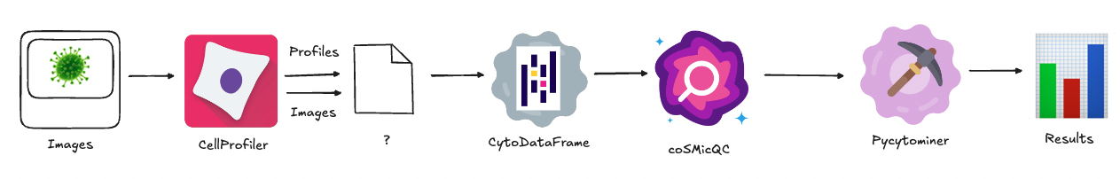
Future
Could we build a format which retains the image data somehow? Ideally:
Strict data types, large data operable, cloud-compatible, and image data compatible.

Slide 33
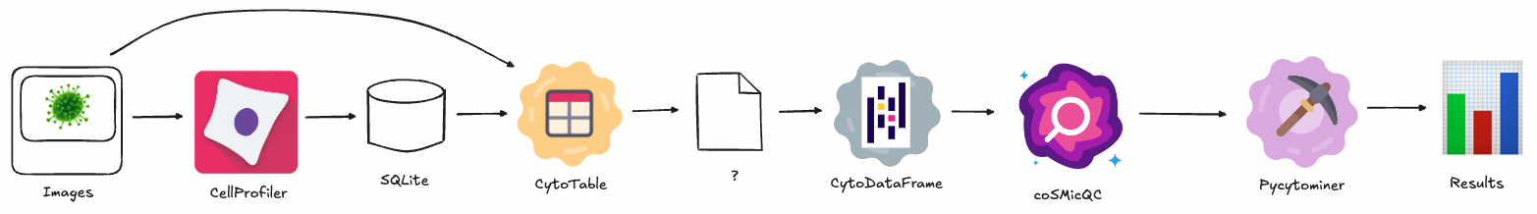
Future
Open source science: in the meantime, we can build it!

Slide 34
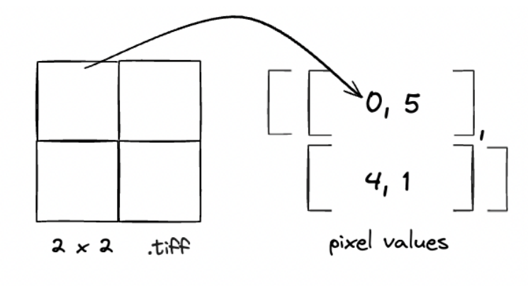
Future
What do you mean image data compatible? Image data as arrays.

Slide 35
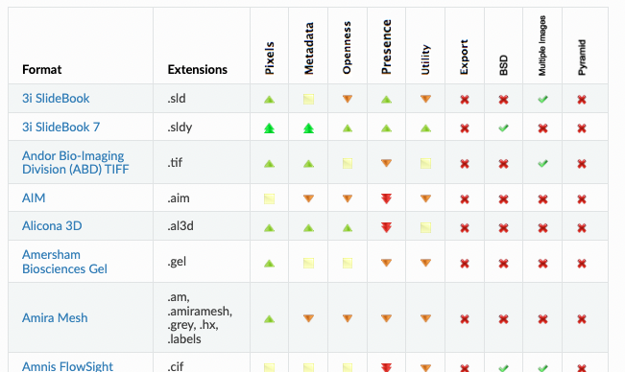
Future
Why not binary large objects (BLOBs)? Standardizing data readers for binary formats would be chaotic and voids benefits of data typing.
https://bio-formats.readthedocs.io/en/v8.0.0/supported-formats.html

Slide 36
Future
Why not binary large objects (BLOBs)? Standardizing data readers for binary formats would be chaotic and voids benefits of data typing.
https://bio-formats.readthedocs.io/en/v8.0.0/supported-formats.html

Slide 37
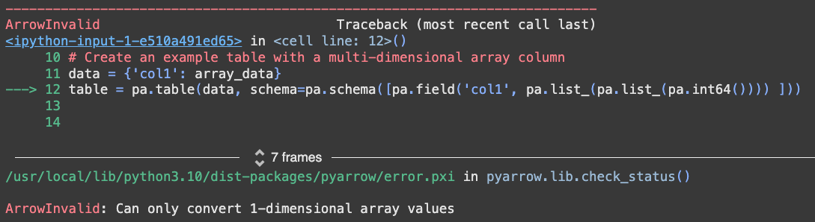
Future
Parquet has issues with array values.
https://colab.research.google.com/drive/1DJ3z5zhKc5wO8rs5GYdT0h9y6cgMCWXy

Slide 38

Future
Lance includes:
Strict data typing
Large data operation compatible
Cloud compatibilities
Array value handling
https://github.com/lancedb/lance

Slide 39
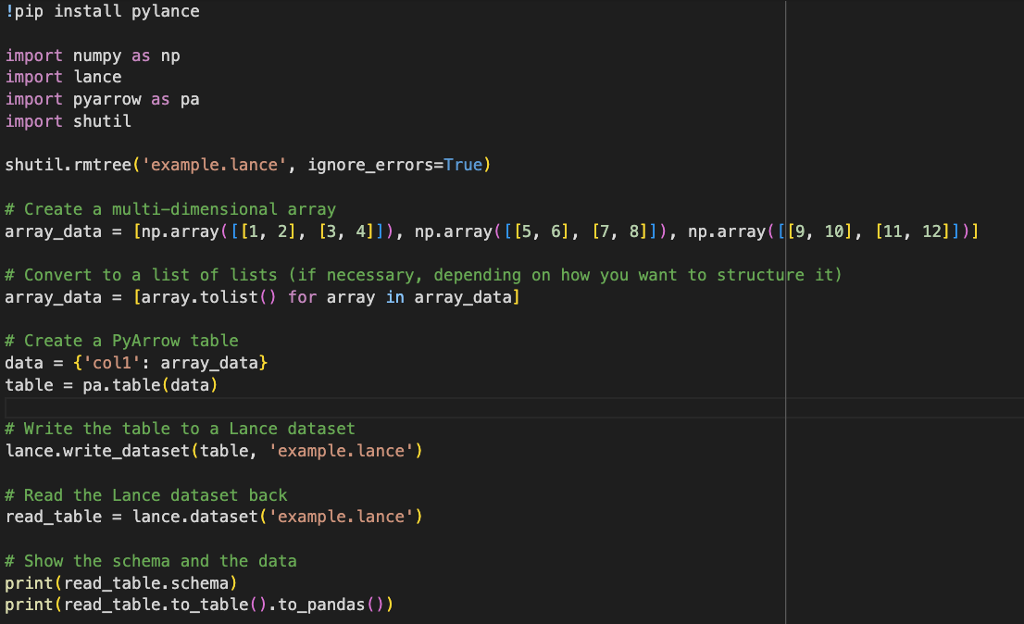
Future
https://colab.research.google.com/drive/10dEpmtC1_pGm2qyc771DsqgVeNXnFQ85

Slide 40
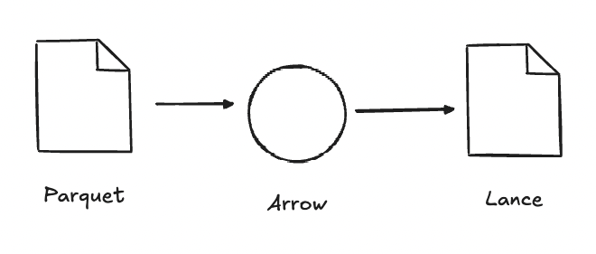
Future
Lance uses Apache Arrow, meaning existing Parquet are backwards compatible.

Slide 41
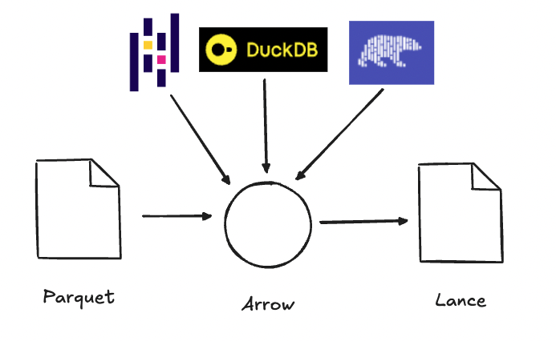
Future
This also means we can use our favorite data analytics engines (so long as they’re compatible with Apache Arrow).

Slide 42
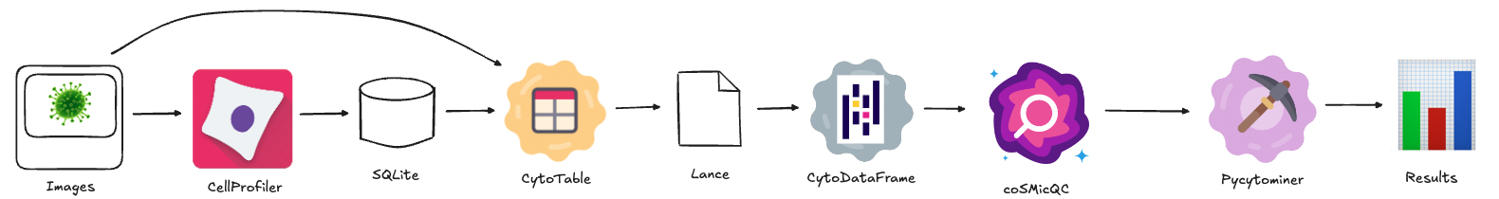
What if … ?

Slide 43
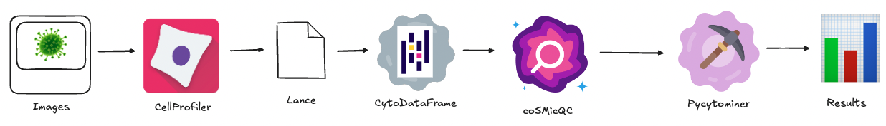
What if … ?
This work could be a stopgap to further complexity reduction,
increasing research velocity.

Slide 44
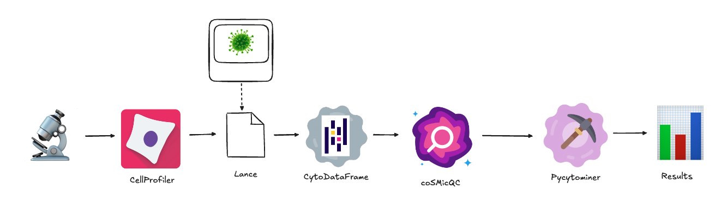
What if … ?
What if …?

Slide 45
Thanks! Questions / comments?

